Slide 1


Advanced Computer Architecture System-on-Chip
By Amirreza Hosseini
Dr. Farbeh

Slide 2
SOC architecture and design
system-on-chip (SOC)
processors: become components in a system
SOC covers many topics
processors, cache, memory, interconnect, design tools
need to know
user view: variety of processors
basic information: technology and tools
processor internals: effect on performance
storage: cache, embedded and external memory
interconnect: buses, network-on-chip
evaluation: processor, cache, memory, interconnect
advanced: specialized processors, reconfiguration
design productivity: system modelling, design exploration

Slide 3
System on a Chip: driven by semiconductor advances

Slide 4
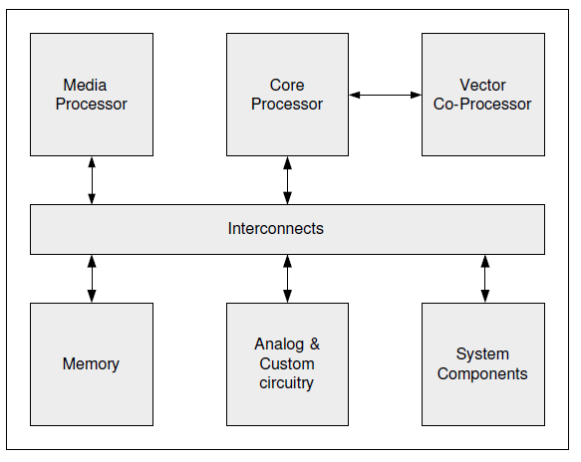
Basic system-on-chip model

Slide 5
SOC vs processors on chip
with lots of transistors, designs move in 2 ways:
complete system on a chip
multi-core processors with lots of cache
 | System on chip | Processors on chip
processor | multiple, simple, heterogeneous | few, complex, homogeneous
cache | one level, small | 2-3 levels, extensive
memory | embedded, on chip | very large, off chip
functionality | special purpose | general purpose
interconnect | wide, high bandwidth | often through cache
power, cost | both low | both high
operation | largely stand-alone | need other chips

Slide 6
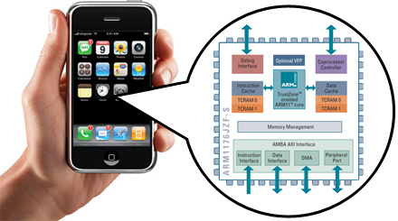
iPhone: has System-on-Chip

Slide 7
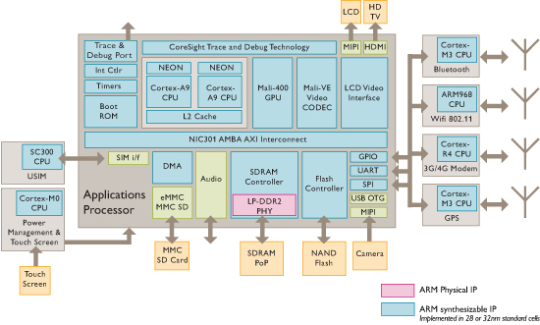
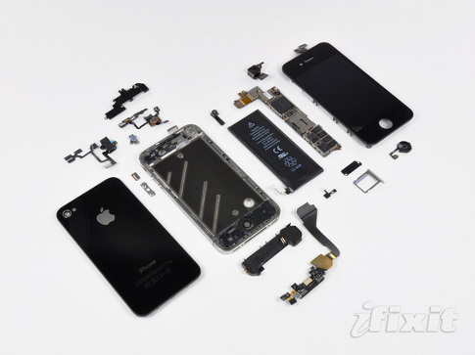
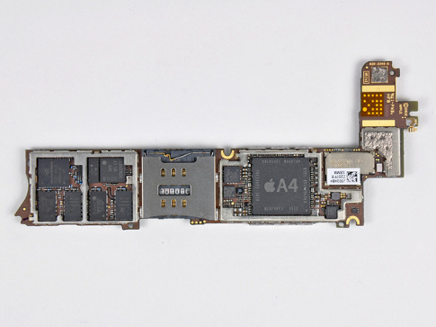
iPhone SOC
I/O
Processor
1 GHz ARM Cortex A8
I/O
I/O
Memory
7

Slide 8
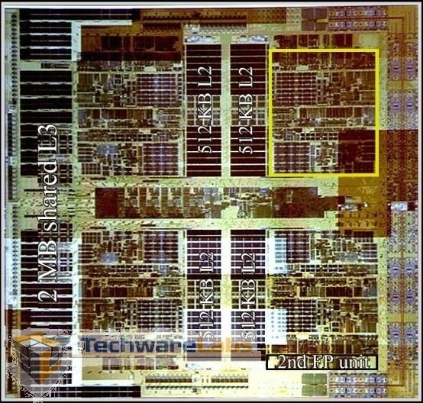
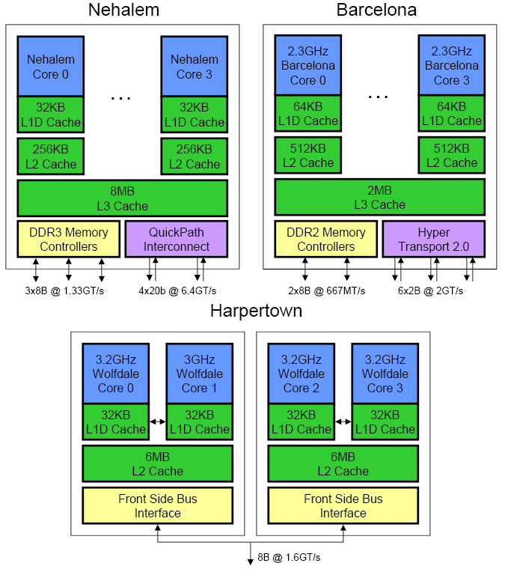
AMD’s Barcelona Multicore Processor
4 out-of-order cores
1.9 GHz clock rate
65nm technology
3 levels of caches
integrated Northbridge
Core 1
512KB L2
Core 2
512KB L2
2MB shared L3 Cache
Northbridge
Core 3
512KB L2
Core 4
512KB L2
http://www.techwarelabs.com/reviews/processors/barcelona/

Slide 9



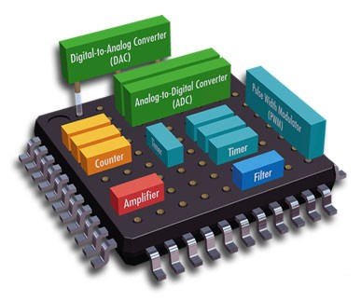





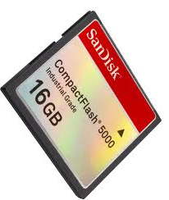

Why System on Chip
LCD, TFT display
Video camera
GPS
802.11
LAN
Keypad
Camera
Radio
Compact Flash
http://www.c-p-e.be/cypros/

Slide 10
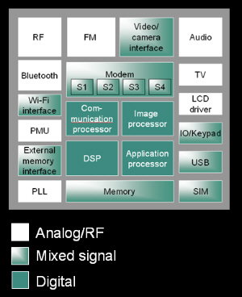
System of Chip Components
Analog
Digital
Memory
Software/ OS
Set top box
http://low-powerdesign.com/cadence_karnane.htm

Slide 11
SoC Hardware Architecture
Often used in embedded application.
How to implement an application on a HW platform executing some SW programs?
source: wiki

Slide 12
SOC design: key ideas
to design and evaluate an SOC, designers need to understand:
its components: processors, memory, interconnect
applications that it targets
SOC economics heavily dependent on:
costs: initial design, marginal production
volume: applicability, lifetime
reducing design complexity
Intellectual Property (IP)
reconfigurable technology

Slide 13
SOC processors
usually a mix of special and general purpose (GP)
can be proprietary design or purchased IP
commonly GP processor is purchased IP
includes OS and compiler support
GP processor optimized for an application
additional instructions
vector units

Slide 14
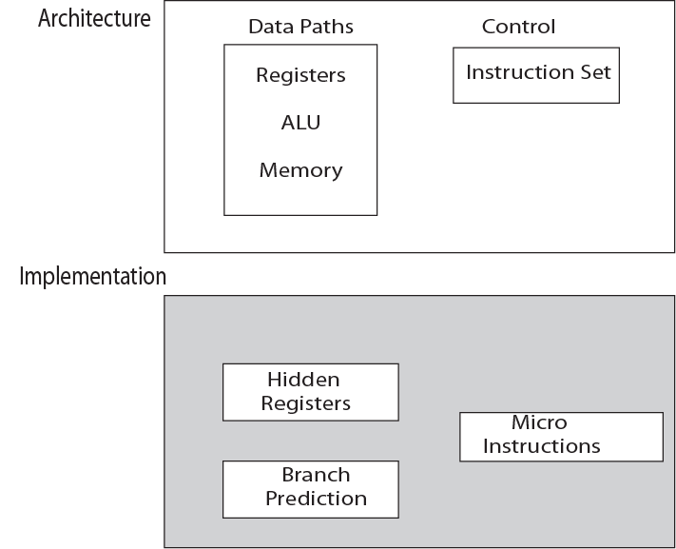

Slide 15
Research
Interconnect topologies
e.g. bus
Hybrid modules, Analog, Digital, ASIP, i.e. integration of mixed signal elements.
On chip communication, power, switching delay, performance such as throughput.
Hardware software co design for reuse.
Mixed Signal (integrated analog blocks such as A to D and D to A converters, phase-locked loops, and adaptive filters.)

Slide 16
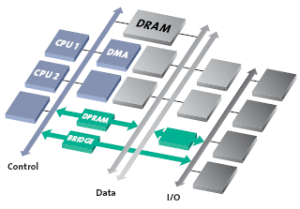
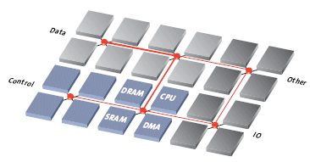
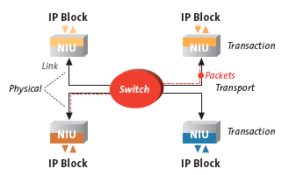
Traditional architecture
Current NOC (arteris.com)

Slide 17
Interconnect topologies
Bus
Star
Cube
Tree
Spin

Slide 18
Some processors for SOCs
SOC | Basic ISA | Processor description
Freescale c600: signal processing | PowerPC | Superscalar with vector extension
ClearSpeed CSX600: general | Proprietary | Array processor with 96 processing elements
PlayStation 2: gaming | MIPS | Pipelined with 2 vector coprocessors
ARM VFP11: general | ARM | Configurable vector coprocessor

Slide 19
Processor types: overview
Processor type | Architecture / Implementation approach
SIMD | Single instruction applied to multiple functional units
Vector | Single instruction applied to multiple pipelined registers
VLIW | Multiple instructions issued each cycle under compiler control
Superscalar | Multiple instructions issued each cycle under hardware control

Slide 20
Adding instructions
additional instructions to support specialized resources
exception: superscalar, with hardware control
instructions can be added to base processor for coprocessor control
VLIW: Very Large Instruction Word
Array
Vector

Slide 21
Sequential and parallel machines
basic single stream processors
pipelined: basic sequential
superscalar: transparently concurrent
VLIW: compiler generated concurrency
multiple stream
array processors
vector processors
multiprocessors

Slide 22
Sequential processors
operation
generally transparent to sequential programmer
appear as in order instruction execution
pipeline processor
execution in order
limited to one instruction execution / cycle
superscalar processor
multi instructions / cycle, managed by hardware
VLIW
multi op execution / cycle, managed by compiler

Slide 23
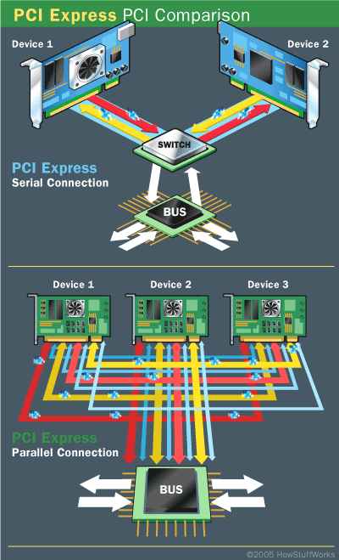
PCI serial and parallel
http://computer.howstuffworks.com/pci-express1.htm

Slide 24
System Chip – Advantages and Issues
Advantages
Easily reprogrammable, reuse of Intellectual property.
Lower chip area, reduce in silicon
Low cost
Issues
On chip routing and timing.
Limitations of On chip resources

Slide 25
Parallel processors
execution managed by programmer
array processors
single instruction stream, multiple data streams: SIMD
vector processors
SIMD
multiprocessors
multiple instruction streams, multiple data streams: MIMD

Slide 26
Memory and addressing
many SOC memory designs use simple embedded memory
a single level cache
real (rather than virtual) addressing
as SOC become more complex
their designs are expected to use more complex memory and addressing configurations

Slide 27
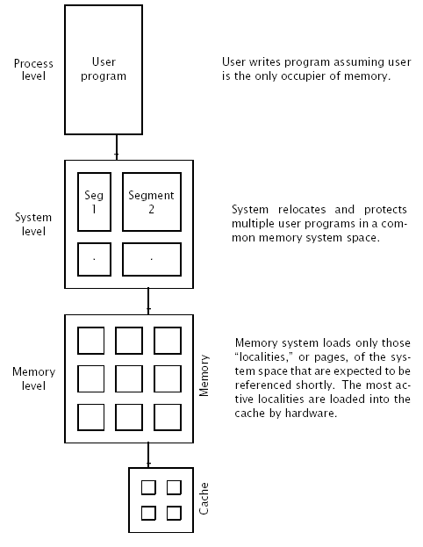
Three levels of
addressing

Slide 28
User view of memory: addressing
a program: process address (offset + base + index)
virtual address: process address + process id
a process: assigned a segment base and bound
system address: segment base + process address
pages: active localities in main/real memory
virtual address: translated by table lookup to real address
page miss: virtual pages not in page table
TLB (translation look-aside buffer): recent translations
TLB entry: corresponding real and (virtual, id) address
a few hashed virtual address bits address TLB entries
if virtual, id = TLB (virtual, id) then use translation

Slide 29
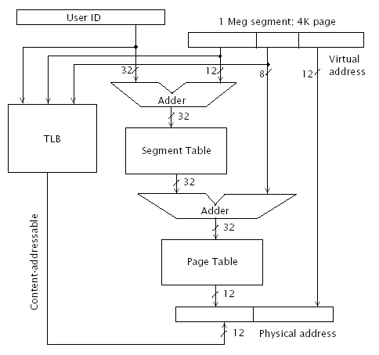
The TLB and
The MMU

Slide 30
SOC interconnect
interconnecting multiple active agents requires
bandwidth: capacity to transmit information (bps)
protocol: logic for non-interfering message transmission
bus
AMBA (adv. Microcontroller bus architecture) from ARM, widely used for SOC
bus performance: can determine system performance
network on chip
array of switches
statically switched: eg mesh
dynamically switched: eg crossbar

Slide 31
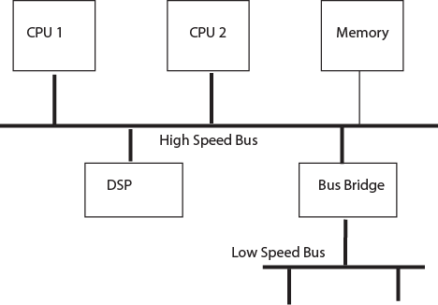
Bus based SOC

Slide 32
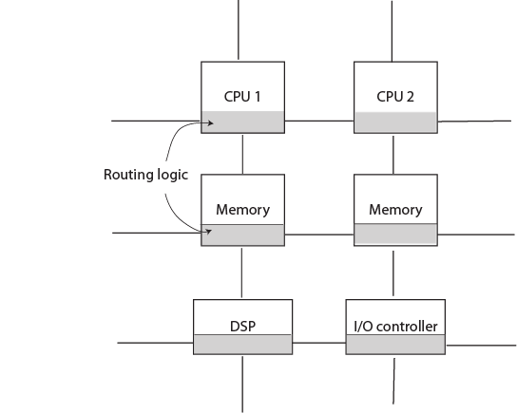
Network on a Chip

Slide 33
Networks-on-Chip (NoCs)

Slide 34
Motivation
Bus has been the most popular interconnect for multiprocessor systems
When scaling feature sizes and frequency, wire delays remain larger than clock cycle
When expanding to a many core-system, contention decreases throughput
Need for interconnect with deterministic delays and scalability

Slide 35
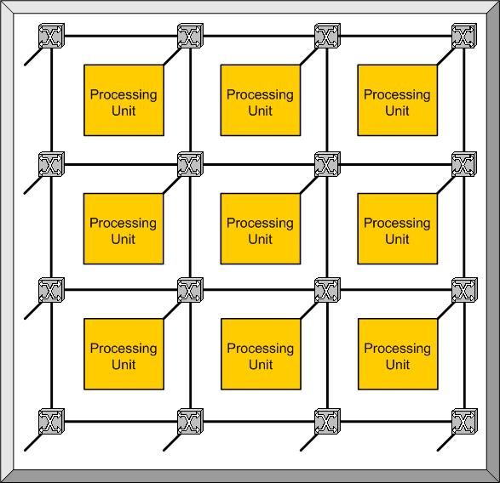
What is a Network-on-Chip (NoC)?
Leveraging existing computer networking principles to improve inter-component intra-chip communications
Each on-chip component connected by an intelligent switch to particular communication wire(s)
Improvement over standard bus based interconnections for SoC architectures in terms of throughput

Slide 36
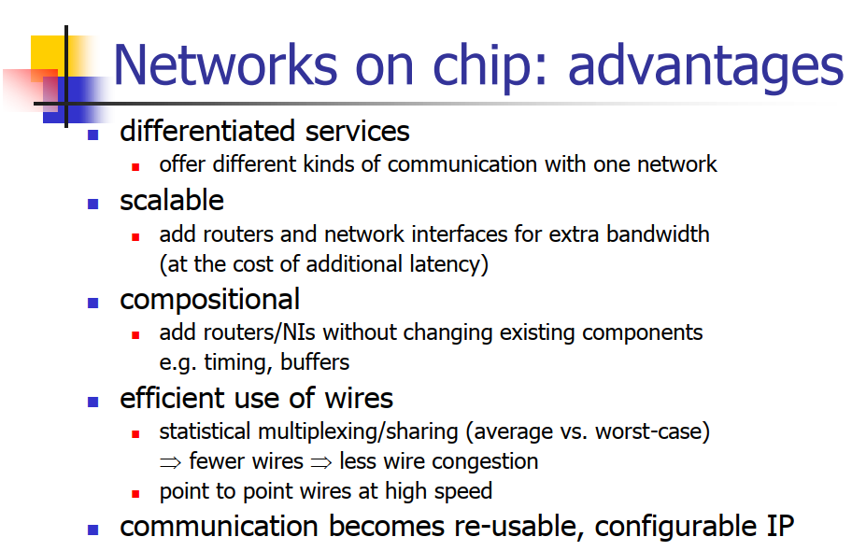

Slide 37
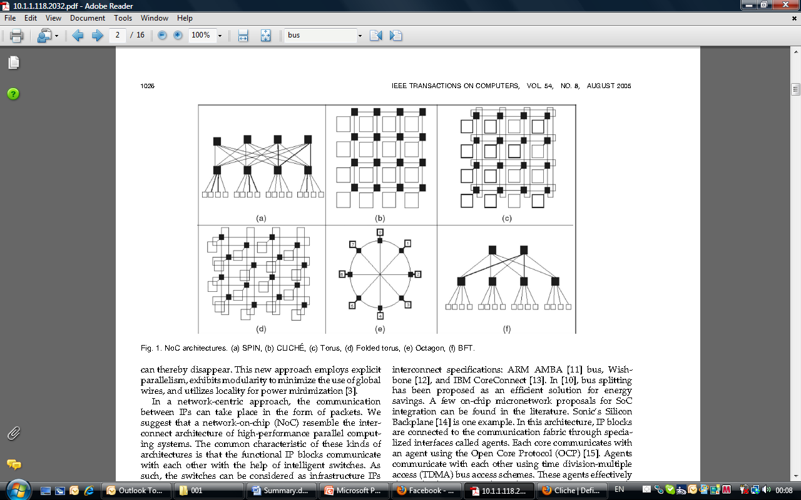
Topologies
CLICHÉ Torus Folded torus

Slide 38
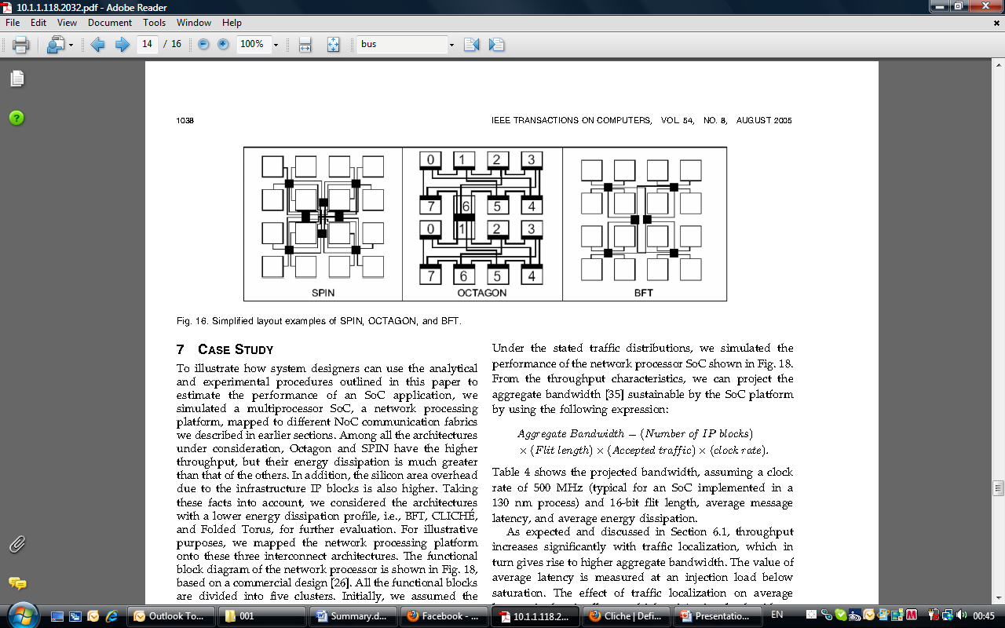
Topologies contd.
SPIN Octagon BFT

Slide 39
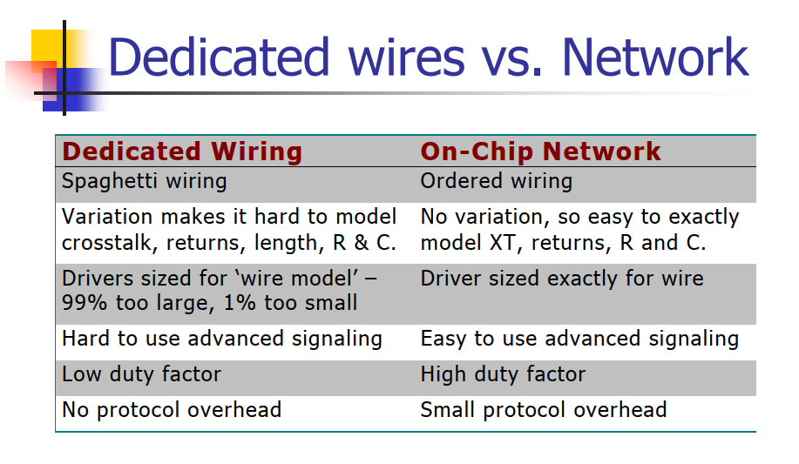

Slide 40
Switching
Circuit Switching
Dedicated path, or circuit, is established over which data packets will travel
Naturally lends itself to time-sensitive guaranteed service due to resource allocation
Reservation of bandwidth decreases overall throughput and increases average delays
Packet Switching
Intermediate routers are now responsible for the routing of individual packets through the network, rather than following a single path
Provides for so-called best-effort services
Sharing of resources allows for higher throughput

Slide 41
Circuit Switching Example
0
Configuration Probe
5
Data
Circuit
Acknowledgement
Significant latency overhead prior to data transfer
Other requests forced to wait for resources

Slide 42
Store & Forward Switching
Intermediate nodes
Destination node
Source node
Each node along a route waits until a packet is completely received (stored) and then the packet is forwarded to the next node
Two resources are needed
Packet-sized buffer in the switch
Exclusive use of the outgoing channel

Slide 43
Store & Forward Switching
S&F switching forwards a packet only when there is enough space available in the receiving buffer to hold the entire packet.
Thus, there is no need for dividing a packet into flits. This reduces the overhead, as it does not require circuits such as a flit builder, a flit decoder, a flit stripper and a flit sequencer.
Nevertheless, such a switching technique requires a large amount of buffer space at each node. Thus, it may not be a feasible solution for embedded applications

Slide 44
Store & Forward Switching Example
High per-hop latency
Larger buffering required

Slide 45
Store & Forward Switching
Finer grained sharing of the link bandwidth
Routing, arbitration, switching overheads experienced for each packet
Increased storage requirements at the nodes
Packetization and in-order delivery requirements
Alternative buffering schemes
Use of local processor memory
Central (to the switch) queues

Slide 46
Switching contd.
Wormhole Switching
Message is divided up into smaller, fixed length flow units called flits
Only first flit contains routing information, subsequent flits follow
Buffer size is significantly reduced due to the limitation on the number of flits needed to be buffered at any given time
Virtual Channels
Allows for several instances of wormhole switching
Additional buffers are added, which increases overall switch size, but significantly increases throughput

Slide 47
Performance Metrics
Simulator developed to measure:
Throughput (in flits)
Latency (of flits)
Energy (per packet)
Hardware model developed to estimate:
Area (router and link overhead)

Slide 48
Network Interface
Transmitter side
Core
Memory
NI
NI
Router
Router
Notes:
48
48

Slide 49
Network Interface
Core
NI
Router
stw r9, 0(r10)
PS
P#
S
D
FT
Notes:
49
49

Slide 50
SOC design approach
understand application (compiler, OS, memory and real time constrains)
select initial die area, power, performance targets; select initial processors, memory, interconnect
assume target processor and interconnect performance, design and evaluate memory
evaluate and redesign processors with memory
design interconnect to support processors and memory
repeat and iterate to optimize

Slide 51
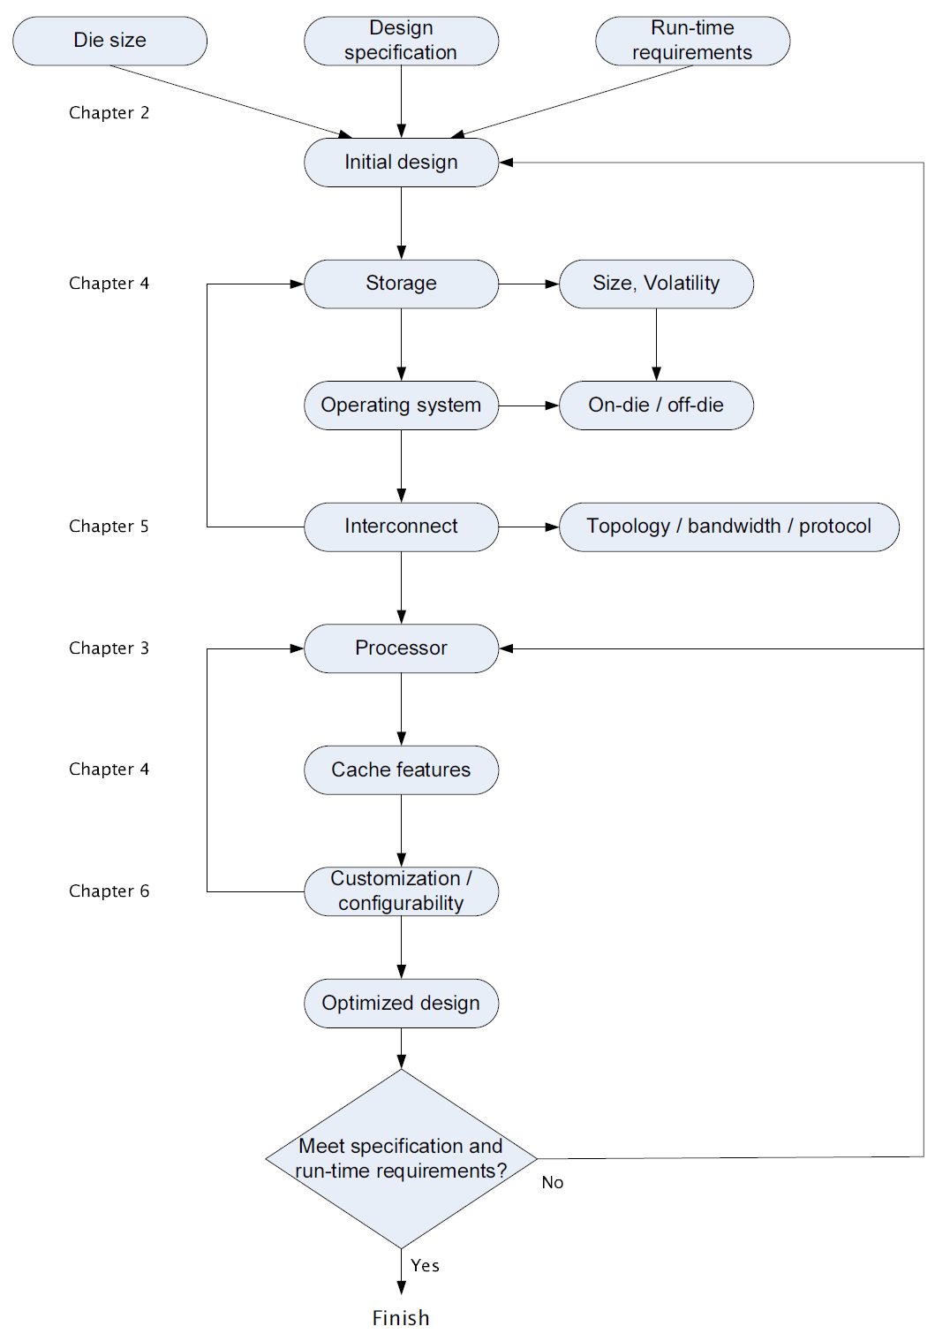
SOC design approach

Slide 52
Processor optimization example
given embedded ARM processor
in an SOC chip
1 IALU vs 2 IALU vs 3 IALU vs 4 IALU
instructions per cycle?
16k L1 instruction cache vs 32k L1 i-cache
how much improvement? less power?
branch predictor: taken vs not-taken
misprediction rate?
aim: explore this large design space

Slide 53
Design cost: product economics
increasingly product cost determined by
design costs, including verification
not marginal cost to produce
manage complexity in die technology by
engineering effort
engineering cleverness

Slide 54
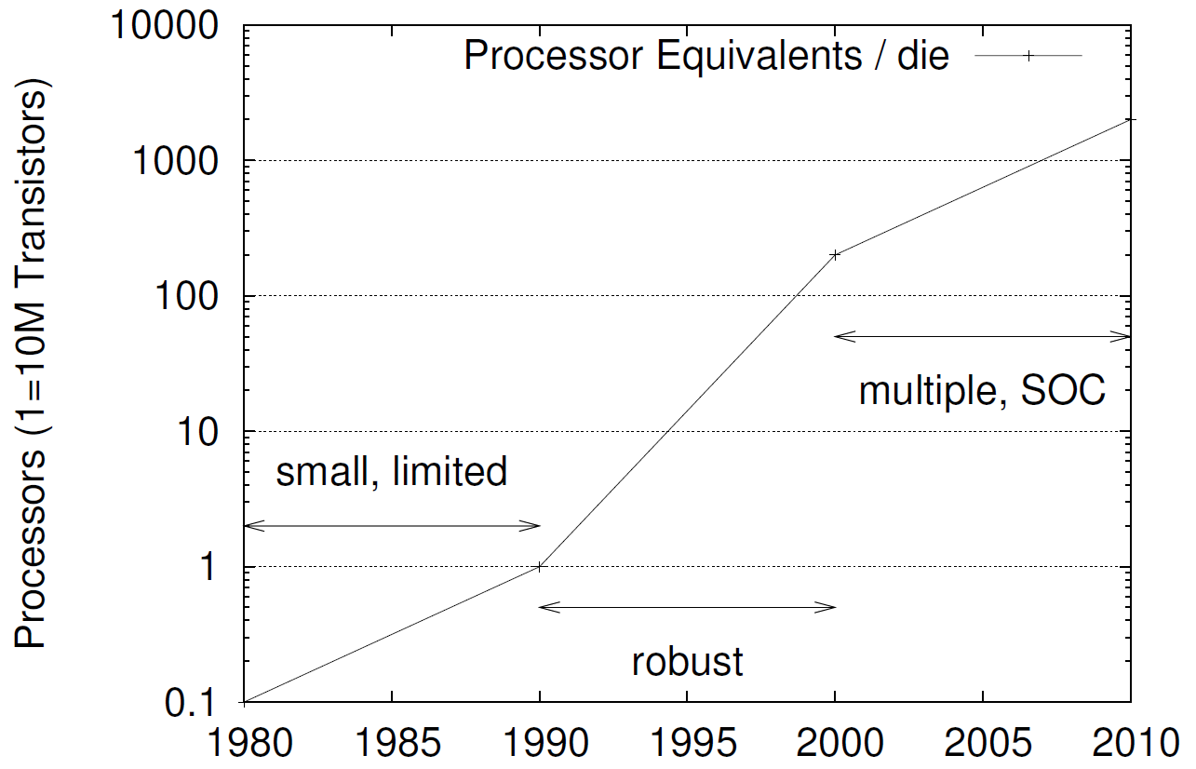
Design complexity

Slide 55
Cost: product program vs engineering

Slide 56
Product volume dictates design effort

Slide 57
Summary
to design and evaluate an SOC, designers need to understand:
its components: processors, memory, interconnect
applications that it targets
SOC economics heavily dependent on:
costs: initial design, marginal production
volume: applicability, lifetime
reducing design complexity
Intellectual Property (IP)
reconfigurable technology

Slide 58

References
Akram Ben Ahmed, Shohei Miura, A. Ben Abdallah, Run-Time Monitoring Mechanism for Efficient Design of Network-on-Chip Architectures, to appear in the 6th International Workshop on Engineering Parallel and Multicore Systems (ePaMuS2013'), July 2013.
Akram Ben Ahmed, A. Ben Abdallah, Low-overhead Routing Algorithm for 3D Network-on-Chip, IEEE Proc. of the The Third International Conference on Networking and Computing (ICNC'12), pp. 23-32, 2012.
Akram Ben Ahmed, A. Ben Abdallah, LA-XYZ: Low Latency, High Throughput Look-Ahead Routing Algorithm for 3D Network-on-Chip (3D-NoC) Architecture, IEEE Proceedings of the 6th International Symposium on Embedded Multicore SoCs (MCSoC-12), pp. 167-174, 2012.
Akram Ben Ahmed, A. Ben Abdallah, ONoC-SPL Customized Network-on-Chip (NoC) Architecture and Prototyping for Data-intensive Computation Applications, IEEE Proceedings of The 4th International Conference on Awareness Science and Technology, pp. 257-262, 2012.
A. Ben Ahmed, A. Ben Abdallah, Efficient Look-Ahead Routing Algorithm for 3D Network-on-Chip (3D-NoC),IEEE Proceedings of the 6th International Symposium on Embedded Multicore SoCs (MCSoC-12,) pp. 167-174,2012.
R. Okada, Architecture and Design of Core Network Interface for Distributed Routing in OASIS NoC, Technical Report, ASL- Parallel Architecture Group, School of Computer Science and Engineering, The University of Aizu, March 2012.
A. Ben Ahmed, A. Ben Abdallah, K. Kuroda,Architecture and Design of Efficient 3D Network-on-Chip (3D NoC) for Custom Multicore SoC, IEEE Proc. of the 5th International Conference on Broadband, Wireless Computing, Communication and Applications (BWCCA-2010), pp.67-73, Nov. 2010. (best paper award) (slides)
K. Mori, A. Esch, A. Ben Abdallah, K. Kuroda, Advanced Design Issues for OASIS Network-on-Chip Architecture, IEEE Proc. of the 5th International Conference on Broadband, Wireless Computing, Communication and Applications (BWCCA-2010),pp.74-79, Nov. 2010. slides
T. Uesaka, OASIS NoC Topology Optimization with Short-Path Link, Technical Report, Systems Architecture Group,March 2011
K. Mori, A. Ben Abdallah, OASIS NoC Architecture Design in Verilog HDL, Technical Report,TR-062010-OASIS, Adaptive Systems Laboratory, the University of Aizu, June 2010. slides
Shohei Miura, Abderazek Ben Abdallah, Kenichi Kuroda, PNoC: Design and Preliminary Evaluation of a Parameterizable NoC for MCSoC Generation and Design Space Exploration, The 19th Intelligent System Symposium (FAN 2009), pp.314-317, Sep.2009.
Kenichi Mori, Abderazek Ben Abdallah, Kenichi Kuroda, Design and Evaluation of a Complexity Effective Network-on-Chip Architecture on FPGA, The 19th Intelligent System Symposium (FAN 2009), pp.318-321, Sep. 2009.
A. Ben Abdallah, T. Yoshinaga and M. Sowa, "Mathematical Model for Multiobjective Synthesis of NoC Architectures", IEEE Proc. of the 36th International Conference on Parallel Processing, Sept. 4-8, 2007.
A. Ben Abdallah, Masahiro Sowa, "Basic Network-on-Chip Interconnection for Future Gigascale MCSoCs Applications: Communication and Computation Orthogonalization", JASSST2006, Dec. 4-9th, 2006.
Book: Multicore Systems-on-Chip: Practical Hardware/Software Design, 2nd Edition, Author: A. Ben Abdallah, Publisher: Springer, (2013) , ISBN-13: 978-9491216916. [Amazon]

